Slide 1
Introduction to Programming Language II(Java)
Fariha Zahin
Lecturer
CSE, Southeast University

Slide 2
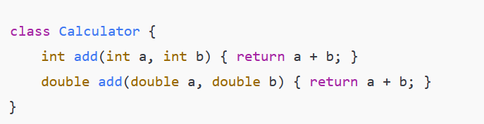
Method Overloading
Definition: Same method name, but different parameters (different type or number) in the same class.

Slide 3
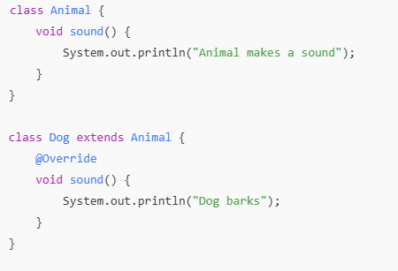
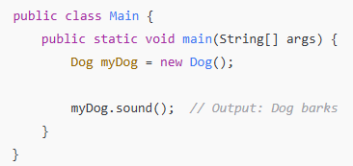
Method Overriding
Definition: Same method name and same parameters between parent and child classes; child class redefines behavior.

Slide 4
Polymorphism
Definition: The ability of an object to take many forms.
**One interface, multiple implementations.
Types of Polymorphism:
Compile-time Polymorphism: Achieved by Method Overloading.
Run-time Polymorphism: Achieved by Method Overriding.

Slide 5
Compile-Time Polymorphism (Static Polymorphism) The method to be executed is determined at compile time.
How it's achieved: Through Method Overloading (same method name, different parameter lists).
Characteristics:
Faster execution since the method call is resolved during compilation.
Happens within the same class.
2. Run-Time Polymorphism (Dynamic Polymorphism) The method to be executed is determined during runtime.
How it's achieved: Through Method Overriding (subclass provides specific implementation of a superclass method).
Characteristics:
Slower than compile-time polymorphism (decision made at runtime).
Requires inheritance (parent and child classes).

